Slide 1


Screening for
Intimate Partner Violence
with Dan
of

Slide 2
Training Objectives
Increase understanding of the dynamics of intimate partner violence (IPV)
Increase awareness of how identity can complicate the dynamics of IPV
Increase ability to address IPV with patients
Increase knowledge of resources

Slide 3
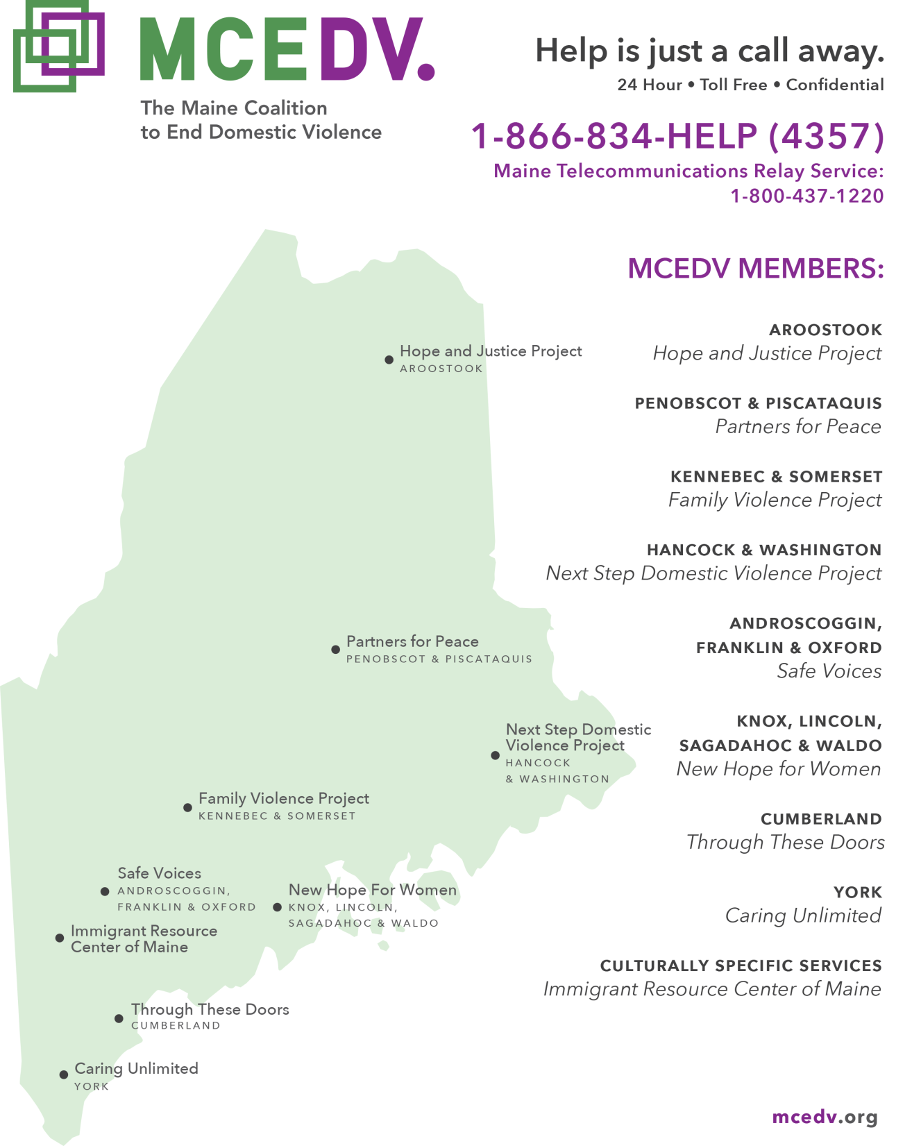
Services & Resources at
TTD & MCEDV
24-hour Helpline
Emergency Shelter
Legal Advocacy
Safety Planning
Support Groups
Pet Placement
Transitional Housing
Children’s Services
School-based Education
Public Awareness & Education
Certified Batterers Intervention Programs
Specialized Training
Volunteer Opportunities
Consultation & collaboration

Slide 4
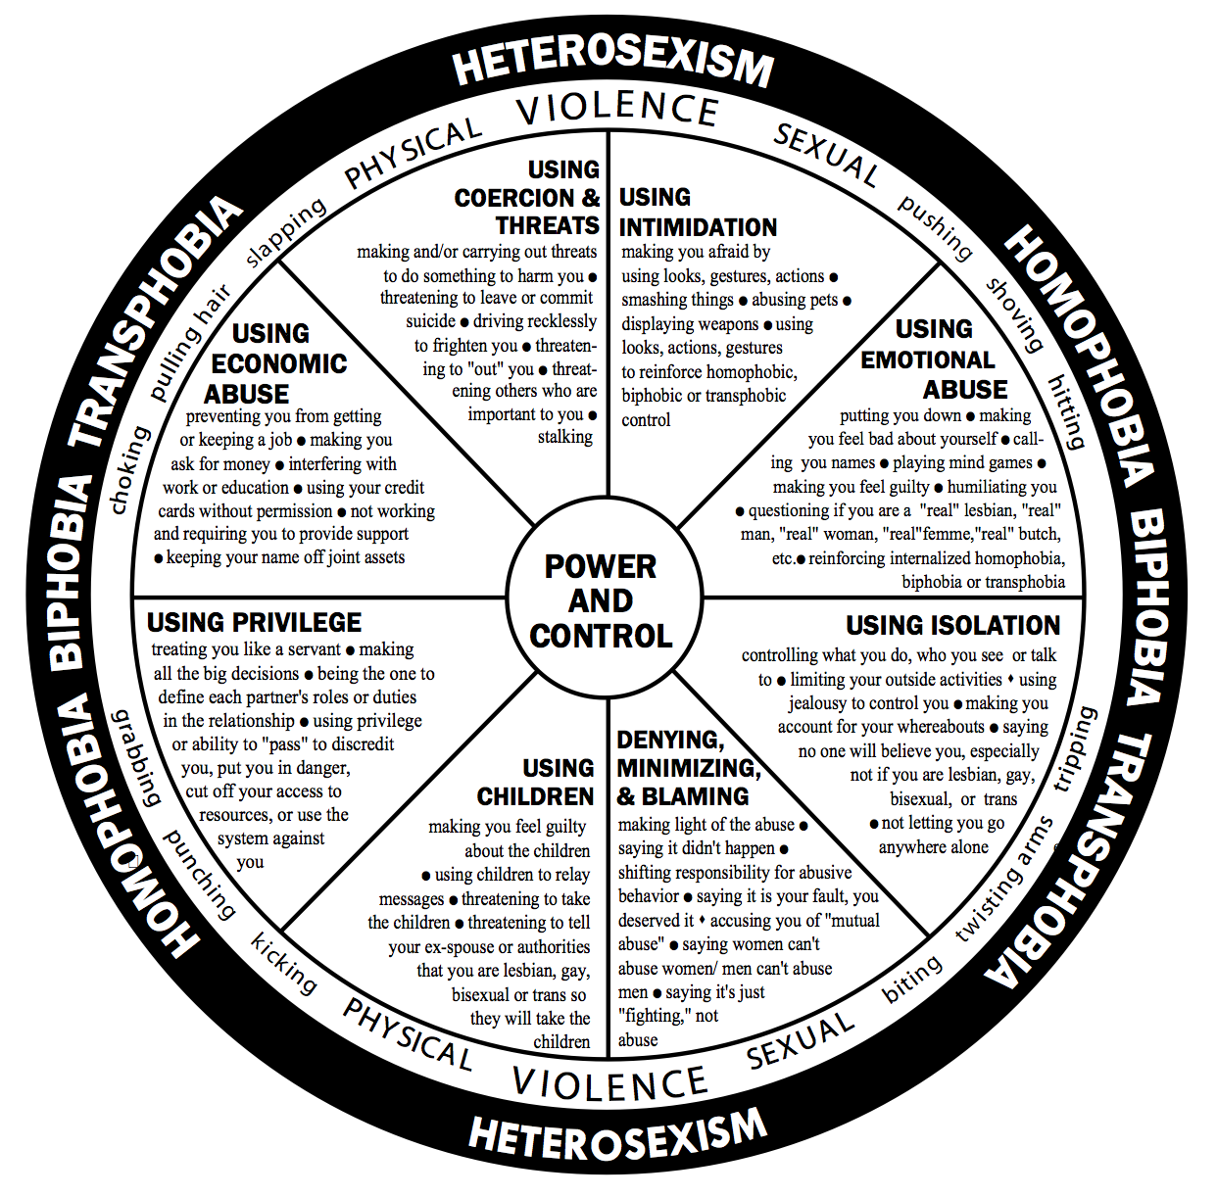

Slide 5
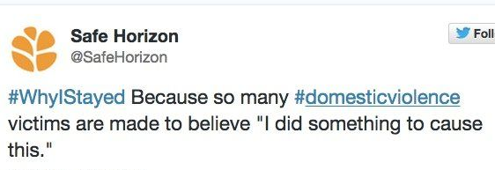
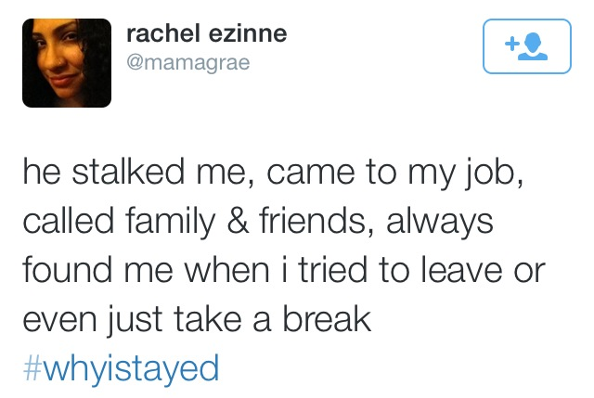


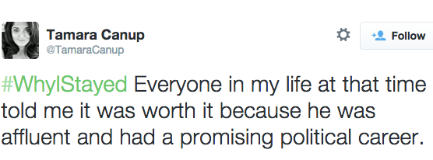
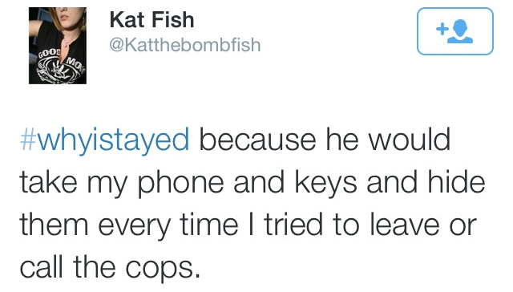


Slide 6

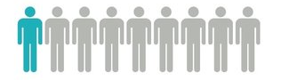


Prevalence of IPV
in heterosexual relationships
in LGBTQ+ relationships

Slide 7
Intersectionality & IPV
Gender & sexual orientation
Age
Culture & religion
Socio-economic status
Citizenship status
Disability & mental health
Rural v. city
Substance use disorder
Experience with criminal justice system

Slide 8
Medical-Specific Red Flags
Multiple missed appointments
Appointments canceled by others
Always accompanied by partner
Partner is overly anxious/concerned
Partner does not allow patient to answer questions
Delay in report of injury or symptoms
Multiple visits for changing symptoms
Symptoms complex, not fitting diagnosis
Non-compliance to medical care

Slide 9
Indicators of High Risk/Lethality
Prior contact with law enforcement
Violating a Protection From Abuse order
Access to firearms
Extreme jealousy & obsessive behavior
Strangulation
Property damage
Animal abuse
Child abuse
Threats of suicide & homicide
Taking hostages
Escalation in abuser’s risk-taking
Pregnancy
Leaving

Slide 10
Why Screen for IPV?
Over half of all the homicides in Maine each year are related to IPV
44% of women murdered by their intimate partner visited an emergency department within two years of the homicide
On average, survivors were screened 7 times before disclosing

Slide 11
Screening for IPV
Framing the Questions
  takes pressure off you & patient
  de-stigmatizes the issue
Questions – the Funnel
  indirect → connection
  contextual information
  direct → specific behaviors

Slide 12
Responding to a Disclosure
  Nonjudgmental
  calm, no “shocked” response – verbally & nonverbally
Validate
  their experience, emotions, bravery in sharing
  “I’m not even sure what to say, I’m just glad you told me.”
Empower w/ Options
  help patient figure out what their next steps could be
    At most: call helpline together
    At least: connection – listen, believe, validate

Slide 13
Making Referrals
Safety
  Use the privacy of your practice
    in the moment, or by scheduling a future appointment
  Use a phone to which abuser doesn’t have access
  Discreet print materials
Warmth
      Offer to call helpline together
      Unconditional support / leave the door open

Slide 14
Services & Resources at
TTD & MCEDV
24-hour Helpline
Emergency Shelter
Legal Advocacy
Safety Planning
Support Groups
Pet Placement
Transitional Housing
Children’s Services
School-based Education
Public Awareness & Education
Certified Batterers Intervention Programs
Specialized Training
Volunteer Opportunities
Consultation & collaboration

